Slide 1
Chapter 13: I/O Systems

Slide 2
Chapter 13: I/O Systems
I/O Hardware
Application I/O Interface
Kernel I/O Subsystem
Transforming I/O Requests to Hardware Operations
Streams
Performance

Slide 3
Objectives
Explore the structure of an operating system’s I/O subsystem
Discuss the principles of I/O hardware and its complexity
Provide details of the performance aspects of I/O hardware and software

Slide 4
I/O Hardware
Incredible variety of I/O devices
Storage device- disks, tapes
Transmission devices- network cards, modems
Human interface device- screen, keyboard ,mouse)
Common concepts
  Port – Device communicates via connection point or port
  Bus – connection of wire used to sent messages(daisy chain or shared direct access- A to device b and then finally to computer)
  Controller (host adapter)- collection of electronics that can operate a port, abus, a device
  COMMON PC SYSTEM BUS

Slide 5
An i/o port typically consists of 4 registers:
Data in reg: register is read by host to get i/p
Data out reg: register is written by host to send o/p
Status reg: contain bits that can be read by the host.wether the current command is executed, whether a device error has occurred
Control regis:written by host to change mode. Choose b/w full duplex, half duplex

Slide 6

A Typical PC Bus Structure

Slide 7
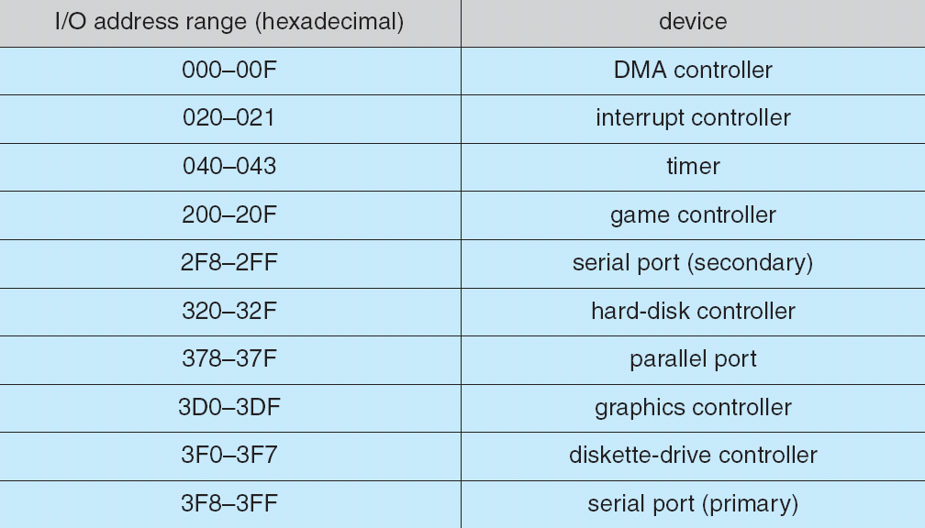
Device I/O Port Locations on PCs (partial)

Slide 8
Polling
It is a mechanism of coordinating host and controller by handshaking phenomenon.
Hosts repeatedly reads the busy bit until that bit becomes clear
The host sets write bit in the command register and writes a byte into the data-out reg
The host sets the command –ready bit
When controller notices the command ready bit is set, it sets the busy bit
The controller reads the command register and sees write command. It reads the data-out register to get the byte
The controller clears the command ready bit , clears the error bit
Determines state of device
  command-ready
  busy
  Error
Busy-wait cycle to wait for I/O from device

Slide 9
Interrupts
Controller raises interrupt by asserting a signal on interrupt request line , cpu catches n dispatches to interrupt handler
CPU Interrupt-request line triggered by I/O device
Interrupt handler receives interrupts
interrupt vector - add
Maskable to ignore or delay some interrupts
Interrupt vector to dispatch interrupt to correct handler
  Based on priority
  Some nonmaskable
Interrupt mechanism also used for exceptions

Slide 10
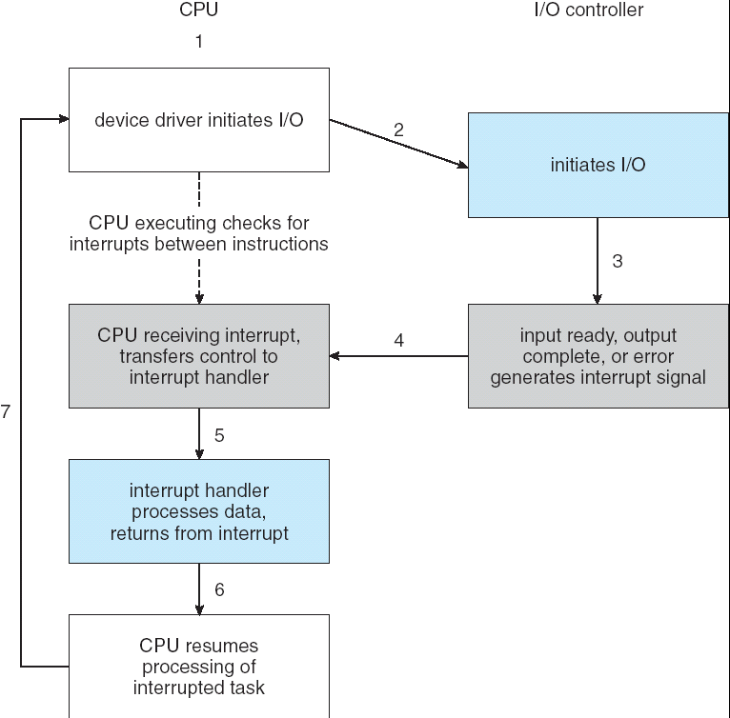
Interrupt-Driven I/O Cycle

Slide 11
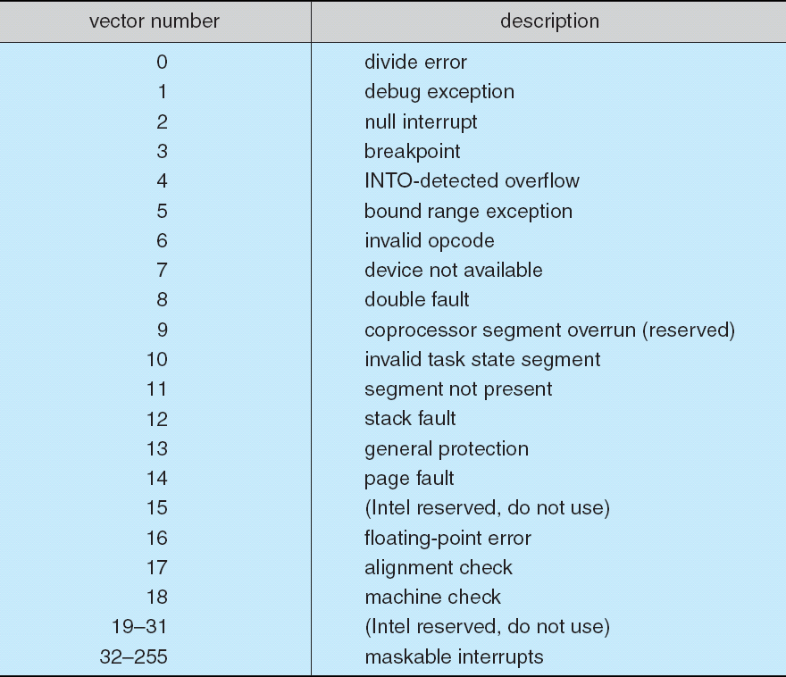
Intel Pentium Processor Event-Vector Table

Slide 12
Direct Memory Access
Used to avoid programmed I/O for large data movement
Requires DMA controller
Bypasses CPU to transfer data directly between I/O device and memory

Slide 13

Six Step Process to Perform DMA Transfer

Slide 14
Application I/O Interface
I/O system calls encapsulate device behaviors in generic classes
Device-driver layer hides differences among I/O controllers from kernel
Devices vary in many dimensions
  Character-stream or block- It transfer bytes one by one, transfers blocks one by one
  Sequential or random-access- transfers data in fixed order determined by the device
  Sharable or dedicated- can be used concurrently by several processes
  Speed of operation- device speeds range from few bytes per second to a few gigaytes per second.
  read-write, read only, or write only- some devices perform both input and output

Slide 15
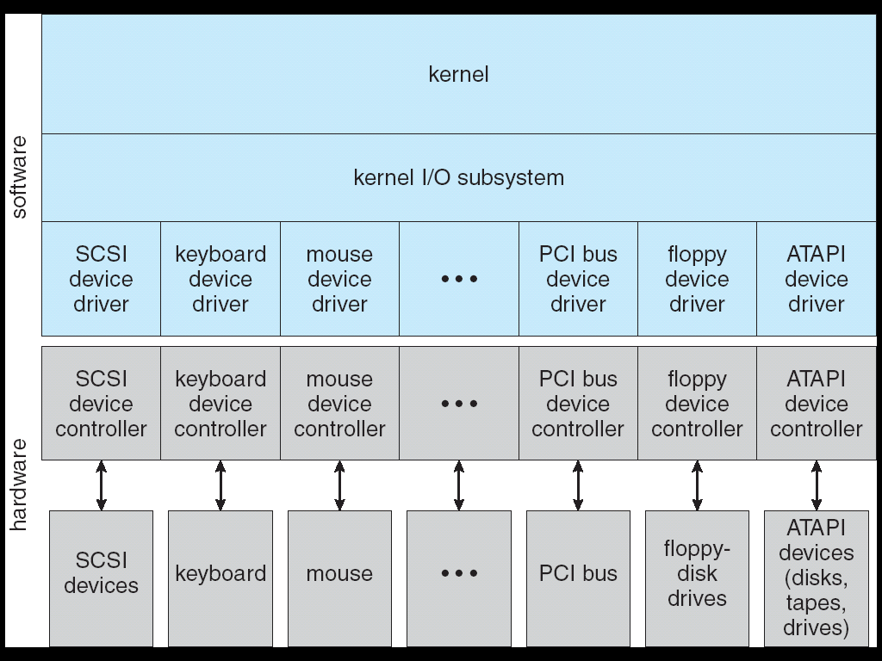
A Kernel I/O Structure

Slide 16
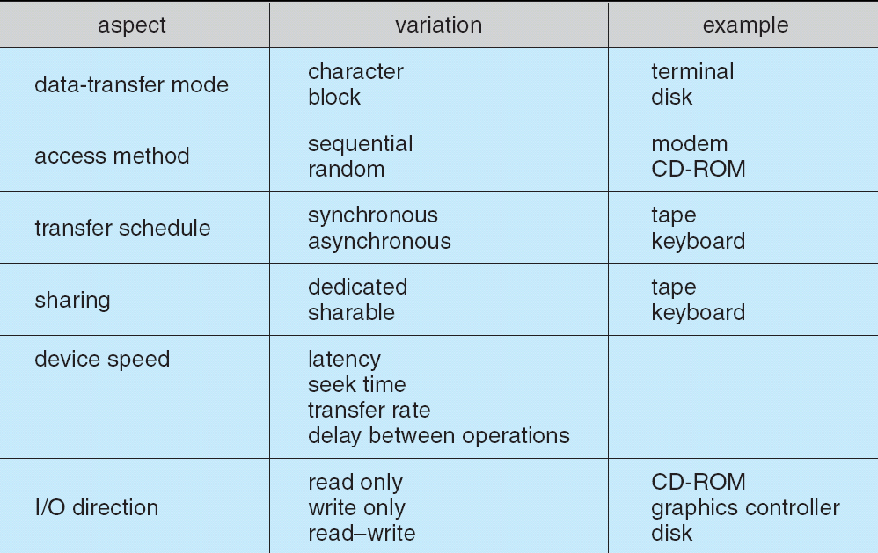
Characteristics of I/O Devices

Slide 17
Block and Character Devices
Block devices include disk drives
  Commands include read(), write(),
  For random access device- seek()- which block to transfer next
  Provides its own locking
  Character stream interface.- get(), put()
  Raw I/O or file-system access
  Memory-mapped file access possible
Character devices include keyboards, mice, serial ports
  Commands include get, put
  Libraries layered on top allow line editing

Slide 18
Network Devices
Varying enough from block and character to have own interface
Unix and Windows NT/9 -network socket interface
  Separates network protocol from network operation
  Includes select functionality
Approaches vary widely (pipes, FIFOs, streams, queues, mailboxes)

Slide 19
Clocks and Timers
Provide current time, elapsed time, Set a timer to trigger operation x at time T
Programmable interval timer used for timings, periodic interrupts
ioctl (on UNIX) covers odd aspects of I/O such as clocks and timers

Slide 20
Blocking and Nonblocking I/O
Blocking system call , the execution of the application is suspended. Application is moved to run queue to wait queue
process suspended until I/O completed
  Easy to use and understand
  Insufficient for some needs- I/O call returns
Nonblocking as much as available
  User interface, data copy (buffered I/O)
  Implemented via multi-threading
  Returns quickly with count of bytes read or written
Asynchronous - process runs while I/O executes
  Difficult to use
  I/O subsystem signals process when I/O completed

Slide 21
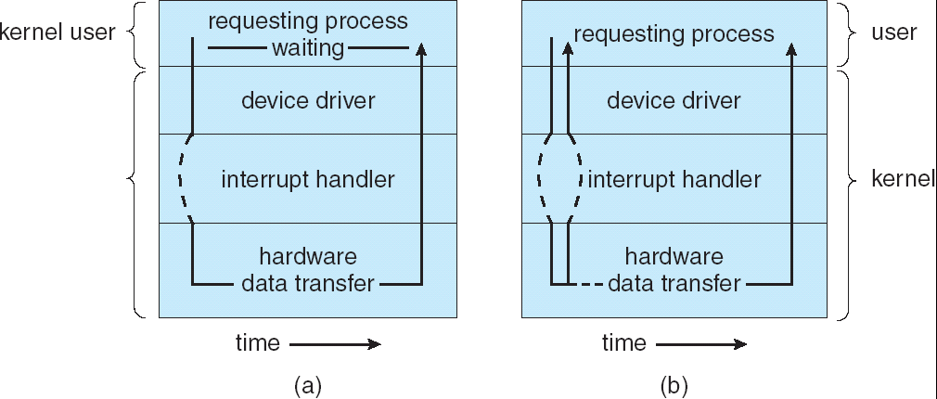
Two I/O Methods
Synchronous
Asynchronous

Slide 22
Kernel I/O Subsystem
Kernel provides following services
Scheduling
  Some I/O request ordering via per-device queue
  Some OSs try fairness
Buffering - store data in memory while transferring between two devices
Second use – is to adapt between devices that have different data transfer size
  To cope with device speed mismatch
  To cope with device transfer size mismatch
  To maintain “copy semantics”

Slide 23
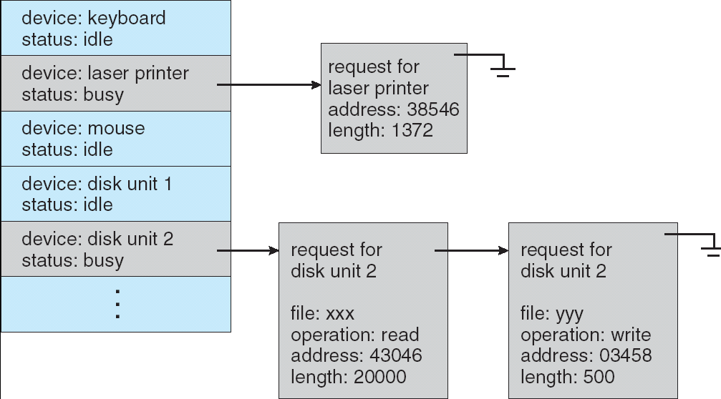
Device-status Table

Slide 24
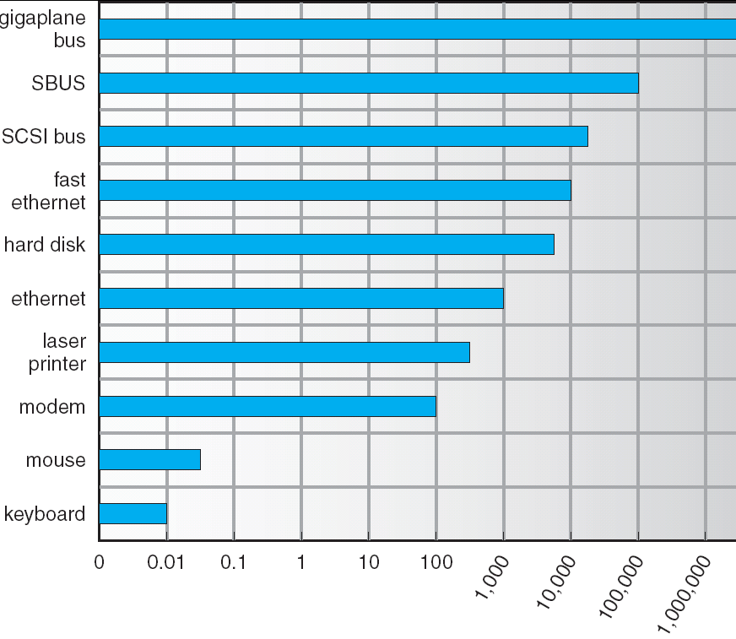
Sun Enterprise 6000 Device-Transfer Rates

Slide 25
Kernel I/O Subsystem
Caching - fast memory holding copy of data
  Always just a copy
  Key to performance
  Existing copy of data item
Spooling - hold output for a device
  If device can serve only one request at a time
  i.e., Printing
Device reservation - provides exclusive access to a device
  System calls for allocation and deallocation
  Watch out for deadlock

Slide 26
Error Handling
OS can recover from disk read, device unavailable, transient write failures
Most return an error number or code when I/O request fails
System error logs hold problem reports

Slide 27
I/O Protection
User process may accidentally or purposefully attempt to disrupt normal operation via illegal I/O instructions
  All I/O instructions defined to be privileged
  I/O must be performed via system calls
    Memory-mapped and I/O port memory locations must be protected too

Slide 28
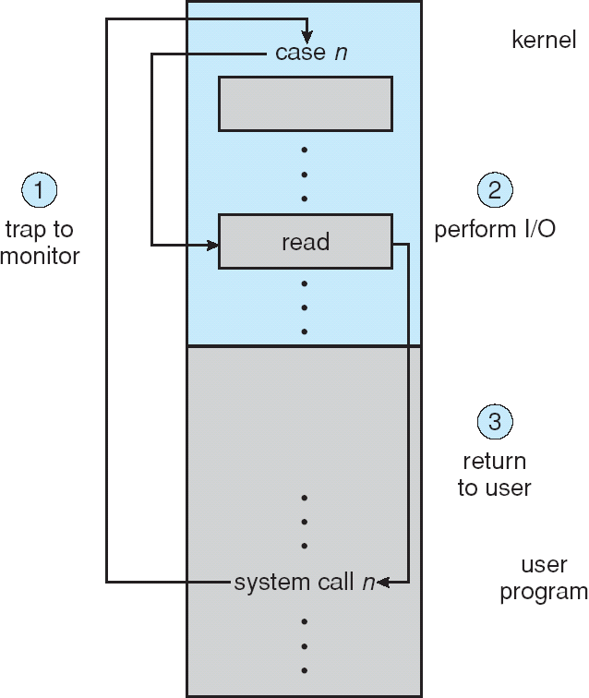
Use of a System Call to Perform I/O

Slide 29
Kernel Data Structures
Kernel keeps state info for I/O components, including open file tables, network connections, character device state
Many, many complex data structures to track buffers, memory allocation, “dirty” blocks
Some use object-oriented methods and message passing to implement I/O

Slide 30
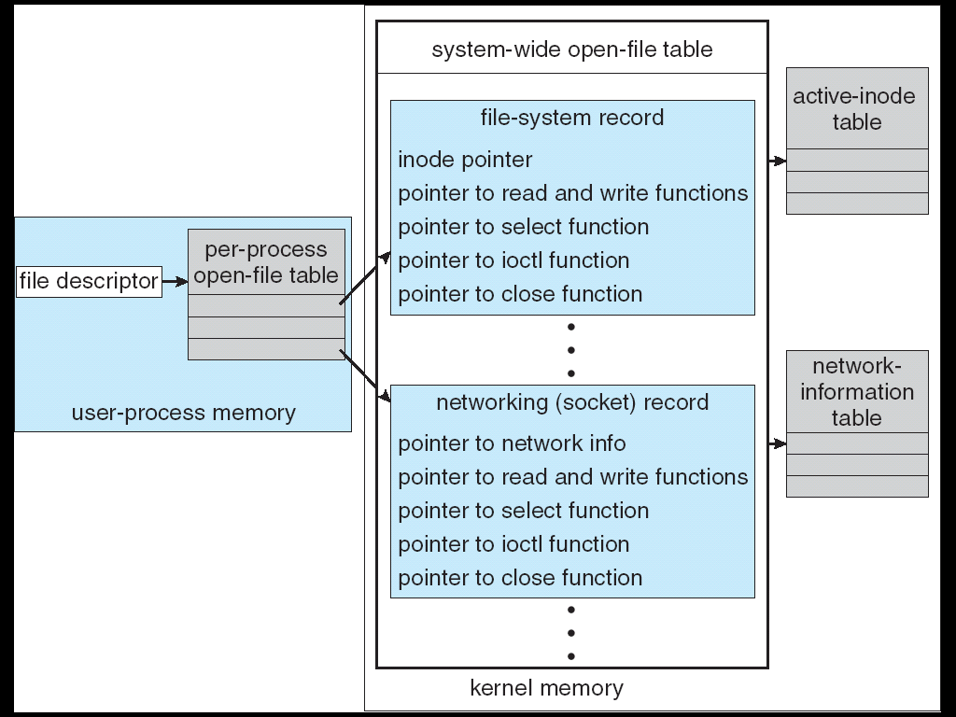
UNIX I/O Kernel Structure

Slide 31
I/O Requests to Hardware Operations
Consider reading a file from disk for a process:
  Determine device holding file
  Translate name to device representation
  Physically read data from disk into buffer
  Make data available to requesting process
  Return control to process

Slide 32
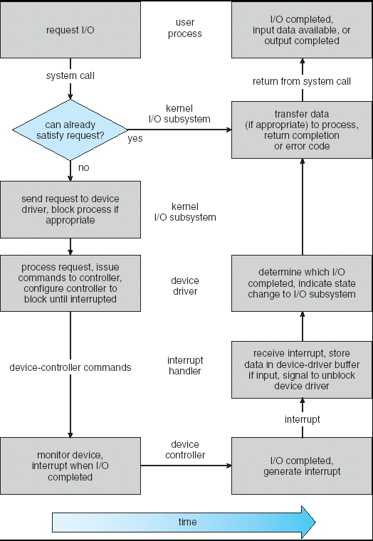
Life Cycle of An I/O Request

Slide 33
STREAMS
STREAM – a full-duplex communication channel between a user-level process and a device in Unix System V and beyond
A STREAM consists of:
- STREAM head interfaces with the user process
- driver end interfaces with the device
- zero or more STREAM modules between them.
Each module contains a read queue and a write queue
Message passing is used to communicate between queues

Slide 34
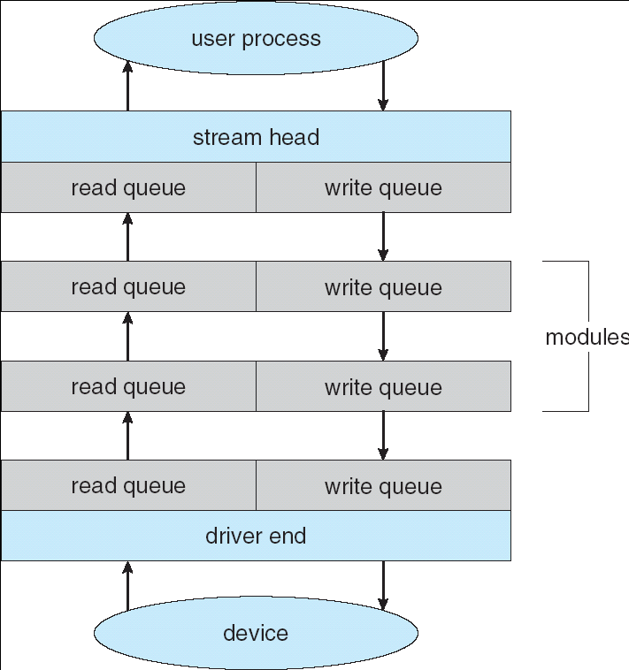
The STREAMS Structure

Slide 35
Performance
I/O a major factor in system performance:
  Demands CPU to execute device driver, kernel I/O code
  Context switches due to interrupts
  Data copying
  Network traffic especially stressful

Slide 36
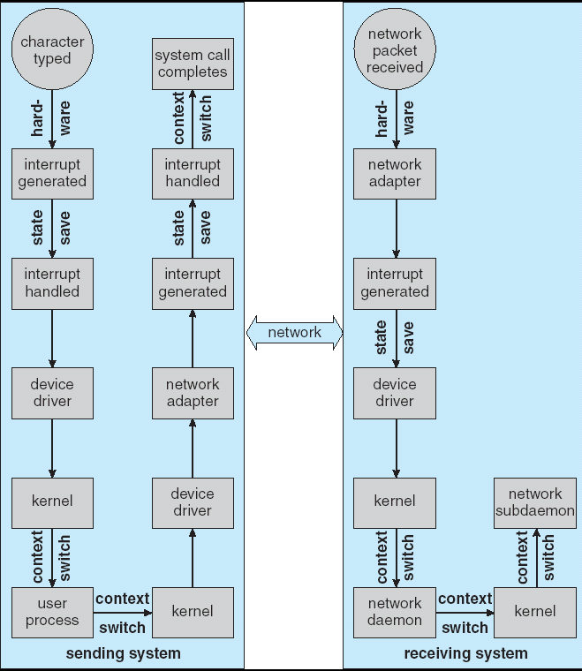
Intercomputer Communications

Slide 37
Improving Performance
Reduce number of context switches
Reduce data copying
Reduce interrupts by using large transfers, smart controllers, polling
Use DMA
Balance CPU, memory, bus, and I/O performance for highest throughput

Slide 38
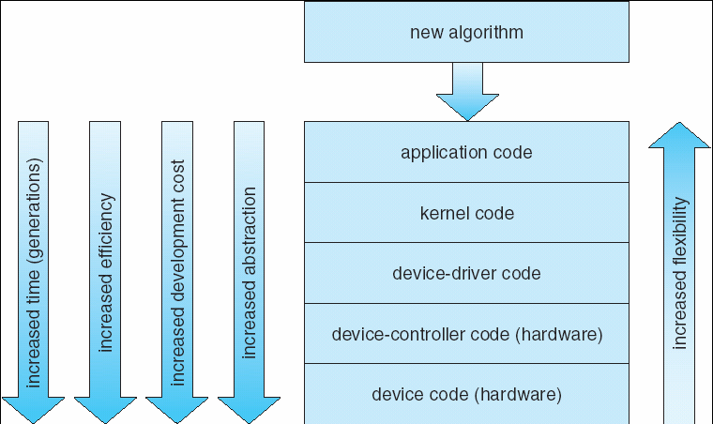
Device-Functionality Progression

Slide 39
End of Chapter 13

